Slide 1

Modern Database Management
Thirteenth Edition, Global Edition
Chapter 2
Modeling Data in the Organization
Copyright © 2020 Pearson Education Ltd. All Rights Reserved
Notes:
If this PowerPoint presentation contains mathematical equations, you may need to check that your computer has the following installed:
1) MathType Plugin
2) Math Player (free versions available)
3) NVDA Reader (free versions available)

Slide 2
Learning Objectives
2.1 Define terms
2.2 Understand importance of data modeling
2.3 Write good names and definitions for entities, relationships, and attributes
2.4 Distinguish unary, binary, and ternary relationships
2.5 Model different types of attributes, entities, relationships, and cardinalities
2.6 Convert many-to-many relationships to associative entities
2.7 Model time-dependent data using time stamps

Slide 3
E-R Model Constructs
Entities:
Entity instance – person, place, object, event, concept (often corresponds to a row in a table)
Entity Type – collection of entities (often corresponds to a table)
Relationships:
Relationship instance – link between entities (corresponds to primary key–foreign key equivalencies in related tables)
Relationship type – category of relationship; link between entity types
Attributes:
Properties or characteristics of an entity or relationship type (often corresponds to a field in a table)

Slide 4
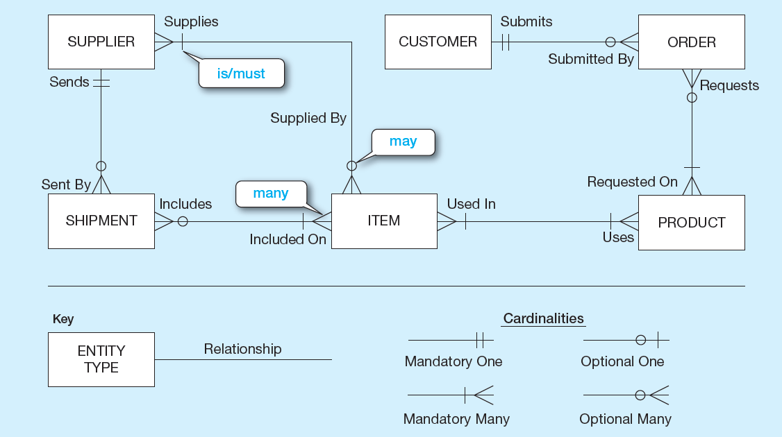
Figure 2-1 Sample E-R Diagram
Notes:
Entity relationship (E-R) diagrams include rectangles representing entities, and lines between the entities representing relationships. Relationships have cardinalities, which can be one-to-one, one-to-many, or many-to-many. In addition, on each side of the relationship you can specify that it is mandatory or optional.

Slide 5
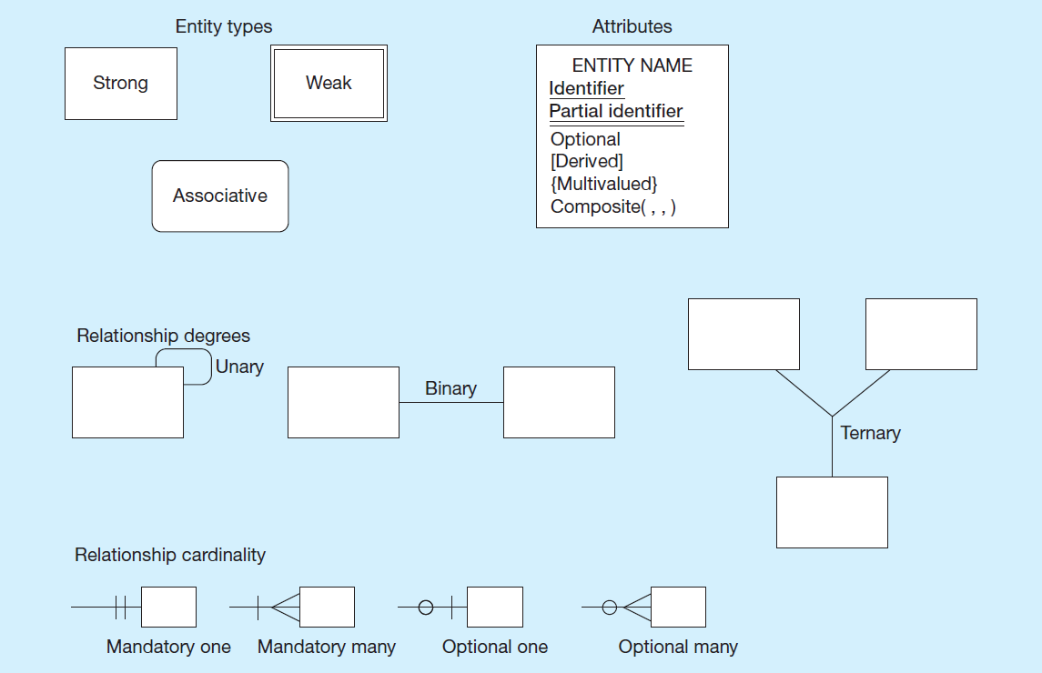
Figure 2-2 Basic E-R Notation
Notes:
Entities can be strong, weak, or associative. This will be explained later.
In addition to cardinalities, relationships also have degrees. A unary degree represents a relationship between entities of the same entity type. A binary degree represents a relationship between entities of two different entity types. A ternary degree represents a relationship between entities of three different entity types. In principle, you can have relationships between any number of entity types, so the term for this degree is “n-ary”.

Slide 6
Business Rules
Are statements that define or constrain some aspect of the business
Are derived from policies, procedures, events, functions
Assert business structure
Control/influence business behavior
Are expressed in terms familiar to end users
Are automated through D B M S software
Notes:
A business rule is a statement that defines or constrains some aspect of the business. It is intended to assert business structure or to control or influence the behavior of the business.
Not all business rules are implemented in a database, and it is the responsibility of the database analyst to determine which business rules can be expressed through E-R models and which cannot.

Slide 7
A Good Business Rule Is:
Declarative – what, not how
Precise – clear, agreed-upon meaning
Atomic – one statement
Consistent – internally and externally
Expressible – structured, natural language
Distinct – non-redundant
Business-oriented – understood by business people
Notes:
Business rules appear (possibly implicitly) in descriptions of business functions, events, policies, units, stakeholders, and other objects. These descriptions can be found in interview notes from individual and group information systems requirements collection sessions, organizational documents (e.g., personnel manuals, policies, contracts, marketing brochures, and technical instructions), and other sources. Rules are identified by asking questions about the who, what, when, where, why, and how of the organization.
Gathering business rules requires good interviewing and listening skills. As a database analyst, you will ask questions about the who, what, when, where, why, and how of the organization. You’ll need to be persistent in clarifying initial statements of rules because initial statements may be vague or imprecise, so this is an iterative inquiry process.

Slide 8
A Good Data Name is:
Related to business, not technical, characteristics
Meaningful and self-documenting
Unique
Readable
Composed of words from an approved list
Repeatable
Written in standard syntax
Notes:
Data objects must be named and defined before they can be used unambiguously in a model of organizational data. Data names refer to the names of entities, their attributes, and their relationships, which are the data objects. These names should be meaningful to the business interests and operations. In a sense, data names should be “self-documenting”, which means they should “obviously” capture the essence of the data object.

Slide 9
Data Definitions
Explanation of a term or fact
Term – word or phrase with specific meaning
Fact – association between two or more terms
Guidelines for good data definition
A concise description of essential data meaning
Gathered in conjunction with systems requirements
Accompanied by diagrams
Achieved by consensus and iteratively refined
Notes:
It is difficult to obtain a universally agreed-upon data definition. So, you may want to use multiple definitions to cover the various situations, or alternatively, use a very general definition that will cover most situations. With data definitions, as with most organizational knowledge, the person who controls the meaning of data controls the data. Thus, the definition of data is a source of organizational power.

Slide 10
Entities
Entity
a person, a place, an object, an event, or a concept in the user environment about which the organization wishes to maintain data
Entity type
a collection of entities that share common properties or characteristics
Entity instance
a single occurrence of an entity type
Notes:
It is important to distinguish an entity instance from an entity type. For example, an entity may be John Doe, a particular person. But the entity type is “Person” as a concept. When you develop E-R diagrams, the boxes represent entity types, not entity instances. Although we use the word “entity” when describing E-R diagrams, what we are really talking about is “entity types”.

Slide 11
Entity Type and Entity Instances
FIGURE 2-3 Entity type EMPLOYEE with two instances
Entity type: EMPLOYEE
Attributes | Attribute Data Type | Example Instance | Example Instance
Employee Number | CHAR (10) | 64217836 | 53410197
Name | CHAR (25) | Michelle Brady | David Johnson
Address | CHAR (30) | 100 Pacific Avenue | 450 Redwood Drive
City | CHAR (20) | San Francisco | Redwood City
State | CHAR (2) | C A | C A
Zip Code | CHAR (9) | 98173 | 97142
Date Hired | DATE | 03-21-1992 | 08-16-1994
Birth Date | DATE | 06-19-1968 | 09-04-1975
Notes:
Here we see the distinction between an entity type and an entity instance. The entity type is represented in the first two columns of this figure. It includes the names of the various attributes (remember what we talked about regarding data names), as well as the types of data. By contrast, the third and fourth columns represent two entity instances. These would be actual records (or rows) in the final database table that implements this entity type.

Slide 12
An Entity…
Should Be:
An object that will have many instances in the database
An object that will be composed of multiple attributes
An object that we are trying to model
Should Not Be:
A user of the database system
An output of the database system (e.g., a report)
Notes:
A common mistake people make when they are learning to draw E-R diagrams, especially if they are already familiar with data process modeling (such as data flow diagramming), is to confuse data entities with other elements of an overall information systems model. A simple rule to avoid such confusion is that a true data entity will have many possible instances, each with a distinguishing characteristic, as well as one or more other descriptive pieces of data.

Slide 13
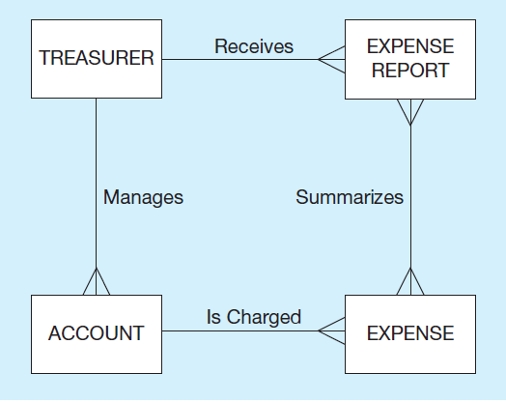

Figure 2-4 Example of Inappropriate Entities
(a) System user (Treasurer) and output (Expense Report) shown as entities
b) E-R diagram with only the necessary entities
Notes:
This figure illustrates a mistake many novices will make. The treasurer is a user of the system, and the expense report is an output of the system. Neither of these are entities that should be represented in the database or the E-R model. The E-R model should represent the objects that are of interest to the user and that will be displayed in the system output.

Slide 14
Strong versus. Weak Entities, and Identifying Relationships
Strong entity
exists independently of other types of entities
has its own unique identifier
identifier underlined with single line
Weak entity
dependent on a strong entity (identifying owner); cannot exist on its own
does not have a unique identifier (only a partial identifier)
entity box and partial identifier have double lines
Identifying relationship
links strong entities to weak entities
Notes:
Most of the basic entity types to identify in an organization are classified as strong entity types. A strong entity type is one that exists independently of other entity types, so sometimes these are called “independent” entity types. In contrast, a weak entity type is an entity type whose existence depends on some other entity type, so these are sometimes called “dependent” entity types.

Slide 15
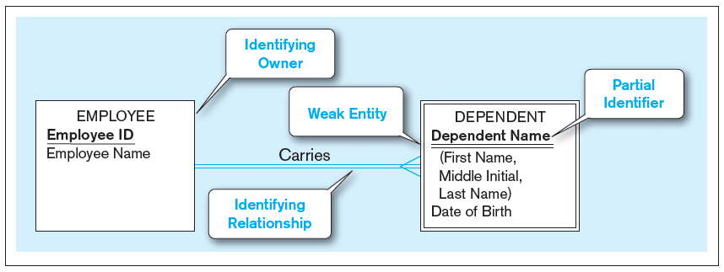
Figure 2-5 Example of a Weak Identity and Its Identifying Relationship
Weak entity with identifying relationship.
Notes:
This figure shows an E-R diagram depicting an identifying relationship between an identifying owner (the employee) and a weak entity (the employer’s dependent). Note that the dependent’s identifier is only a partial identifier. The full identification requires the identifying owner’s identifier as well. Also note the double lines that distinguish the weak entity and the identifying relationship.

Slide 16
Guidelines for Naming Entities
Singular noun
Specific to organization
Concise, or abbreviation
For event entities, the result not the process
Name consistent for all diagrams
Notes:
In addition to general guidelines about naming and defining data objects, there are some specific guidelines for naming entity types. These are listed here.

Slide 17
Guidelines for Defining Entities
“An X is…”
Describe unique characteristics of each instance
Explicit about what is and is not the entity
When an instance is created or destroyed
Changes to other entity types
History that should be kept
Notes:
In addition to general guidelines about naming and defining data objects, there are some specific guidelines for naming entity types. These are listed here.

Slide 18
☑ Check Point
How many of the followings should be modeled as entity? 1-Student 2-Student ID 3-GPA 4-Course 5-Course Credits 6-Prerequisite
A) 2 B) 3 C) 4 D) 5
<--- ANSWER --->
A) 2

Slide 19
Attributes
Attribute – property or characteristic of an entity or relationship type
Classifications of attributes:
Required versus Optional
Simple versus Composite
Single-Valued versus Multivalued
Stored versus Derived
Identifier
Notes:
In naming attributes, we use an initial capital letter followed by lowercase letters. If an attribute name consists of more than one word, we use a space between the words and we start each word with a capital letter, for example, Employee Name or Student Home Address. In E-R diagrams, we represent an attribute by placing its name in the entity it describes.

Slide 20
Figure 2-6 Required versus. Optional Attributes
Entity type: STUDENT
Attributes | Attribute Data Type | Required or Optional | Example Instance | Example Instance
Student I D | CHAR (10) | Required | 28-618411 | 26-844576
Student Name | CHAR (40) | Required | Michael Grant | Melissa Kraft
Home Address | CHAR (30) | Required | 314 Baker St. | 1422 Heft Ave
Home City | CHAR (20) | Required | Centerville | Miami
Home State | CHAR (2) | Required | O H | F L
Home Zip Code | CHAR (9) | Required | 45459 | 33321
Major | CHAR (3) | Optional | M I S | Blank
Required – must have a value for every entity (or relationship) instance with which it is associated
Optional – may not have a value for every entity (or relationship) instance with which it is associated
Notes:
This figure illustrates the various properties of an entity’s attributes. Required attributes must have a value, whereas optional attributes could be null. Note that the identifier is ALWAYS required.
In this case, the student’s major is optional because a student may not yet have declared a major. All the other attributes, however, are required.

Slide 21
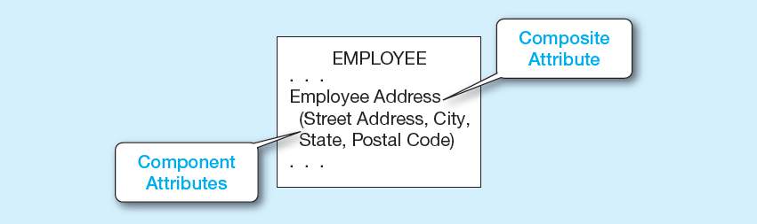
Figure 2-7 A Composite Attribute
Composite attribute – An attribute that has meaningful component parts (sub-attributes)
Notes:
Sometimes many attributes are related to each other, such as the elements of an address. In this case they can be grouped into a composite attribute. For simplicity, we can refer to the “employee address”, but if we want more detail we can break it into street, city, state, and postal code. So, this way, we have the option to describe the attribute at a macro or at a micro level. Note the use of parentheses for encompassing the components of a composite attribute.

Slide 22
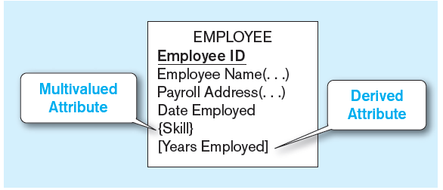
Figure 2-8 Multivalued and Derived Attributes
Multivalued
May take on more than one value for a given entity (or relationship) instance
An employee can have more than one skill
Derived
Values can be calculated from related attribute values (not physically stored in the database)
Years employed calculated from date employed and current date
Notes:
A multivalued attribute is not the same as a composite attribute, although novices may confuse these terms. A composite attribute is one that has many parts, such as an address composed of street, city, state, and zip. By contrast, a multivalued attribute is one that can have many different values, such as an employee being able to do many things.
Note that a derived attribute is not one that is physically stored in the database, but rather one that is calculated based on the value of another. The length of time employed, or a person’s age, are classic examples, as they are calculated based on a fixed starting point (date hired or birth date).
Attributes can be both composite and multivalued, and even also derived. So these are distinct concepts.

Slide 23
Identifiers (Keys)
Identifier (Key) – an attribute (or combination of attributes) that uniquely identifies individual instances of an entity type
Simple versus Composite Identifier
Candidate Identifier – an attribute that could be an identifier; it satisfies the requirements for being an identifier
Notes:
Every entity type should have an identifier attribute. No two instances of the entity type may have the same value for the identifier attribute. For example, a person (employee, student, etc.) cannot rely on the first and last name to be an identifier, because many people could have the same name. Rather, the identifier should be something like an employee ID, a social security number, or some other absolutely unique value.

Slide 24
Criteria for Identifiers
Choose Identifiers that
Will not change in value
Will not be null
Avoid intelligent identifiers (e.g., containing locations or people that might change)
Substitute new, simple keys for long, composite keys
Notes:
An identifier in the E-R model will eventually become a primary key in the resulting database table. We’ll see this in a later chapter. Identifiers are required, so cannot be devoid of value. This value should also be constant and unique. Consider an employee ID or a social security number; these do not change. However, a person’s name or home address could change. Similarly several people could have the same name or address.

Slide 25
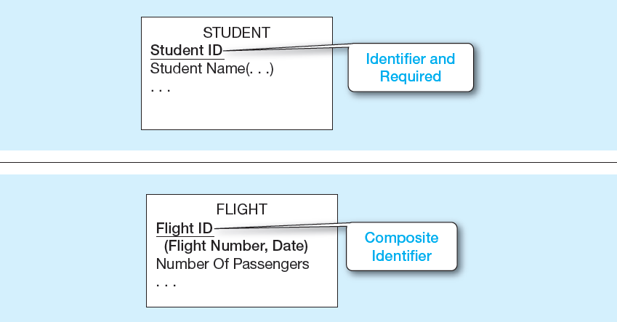
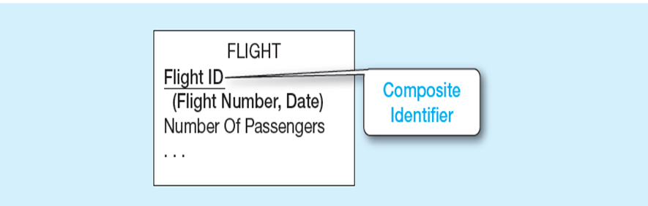
Figure 2-9 Simple and Composite Identifier Attributes
a) Simple identifier attribute
b) Composite identifier attribute
Notes:
In the E-R diagram, an identifier will be underlined. Note also that required attributes are typically boldfaced, so all identifiers will be boldfaced as well. If an identifier is composite, then all its component parts are required.

Slide 26
Naming Attributes
Name should be a singular noun or noun phrase
Name should be unique
Name should follow a standard format
Similar attributes of different entity types should use the same qualifiers and classes
Notes:
As with all other data objects, there are guidelines for naming and defining attributes. These are listed in this slide and the next.
A common naming format is [Entity type name { [ Qualifier ] } ] Class, where [ . . . ] is an optional clause, and { . . . } indicates that the clause may repeat. Entity type name is the name of the entity with which the attribute is associated. The entity type name may be used to make the attribute name explicit. It is almost always used for the identifier attribute (e.g., Customer ID) of each entity type. Class is a phrase from a list of phrases defined by the organization that are the permissible characteristics or properties of entities (or abbreviations of these characteristics). For example, permissible values (and associated approved abbreviations) for Class might be Name (Nm), Identifier (ID), Date (Dt), or Amount (Amt). Class is required. Qualifier is an optional phrase from a list of phrases defined by the organization that are used to place constraints on classes.

Slide 27
Defining Attributes (1 of 2)
State what the attribute is and possibly why it is important
Make it clear what is and is not included in the attribute’s value
Include aliases in documentation

Slide 28
Defining Attributes (2 of 2)
State source of values
State whether attribute value can change once set
Specify whether required or optional
State min and max number of occurrences allowed
Indicate relationships with other attributes

Slide 29
☑ Check Point
Match the following attributes on the left with the types on the right. 1-StudentID a-Required/Stored 2-DateOfBirth b-Composite 3-Age c-Multivalued 4-Address d-Derived 5-Email e-Identifier A) 1a 2b 3d 4c 5e B) 1e 2a 3d 4b 5c C) 1e 2b 3d 4c 5a D) 1b 2a 3d 4c 5e
<--- ANSWER --->
B) 1e 2a 3d 4b 5c

Slide 30
Modeling Relationships
Relationship Types versus. Relationship Instances
The relationship type is modeled as lines between entity types. The relationship instance is between specific entity instances
Relationships can have attributes
These describe features pertaining to the association between the entities in the relationship
Two entities can have more than one type of relationship between them (multiple relationships)
Associative Entity – combination of relationship and entity

Slide 31
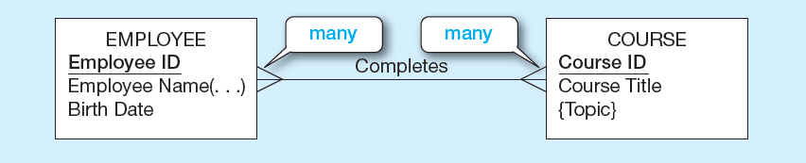
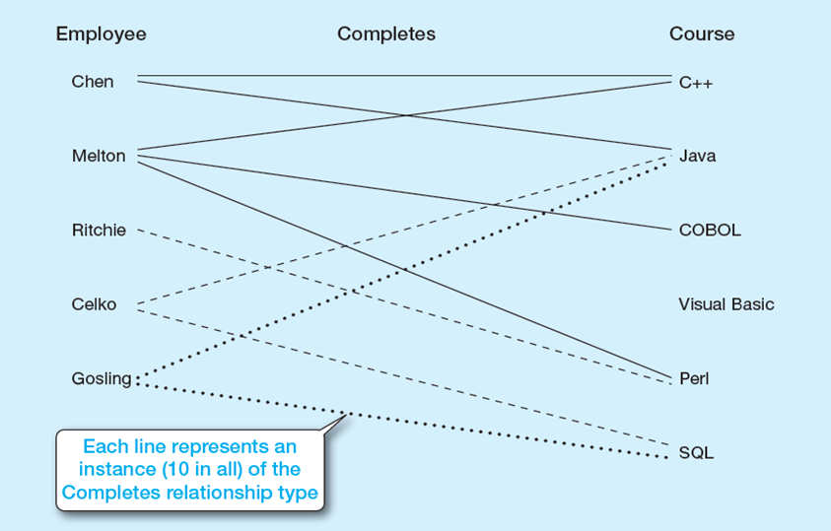
Figure 2-10 Relationship Type and Instances
a) Relational type (Completes)
b) Relationship instances
Notes:
This figure illustrates the difference between relationship types and relationship instances. The E-R diagram depicts types. It depicts both entity types and relationship types. The metadata of the database is modeled based on the entity types. The actual data that goes into the database are instances, both relationship and entity instances.

Slide 32
Degree of Relationships
Degree of a relationship is the number of entity types that participate in it
Unary Relationship
Binary Relationship
Ternary Relationship
Notes:
Most relationships are of binary degree. But it is possible to have any number of entities involved in a relationship. “Ternary” refers to three. If you have more than that, it is sometimes referred to generically as an “n-ary” relationship.

Slide 33
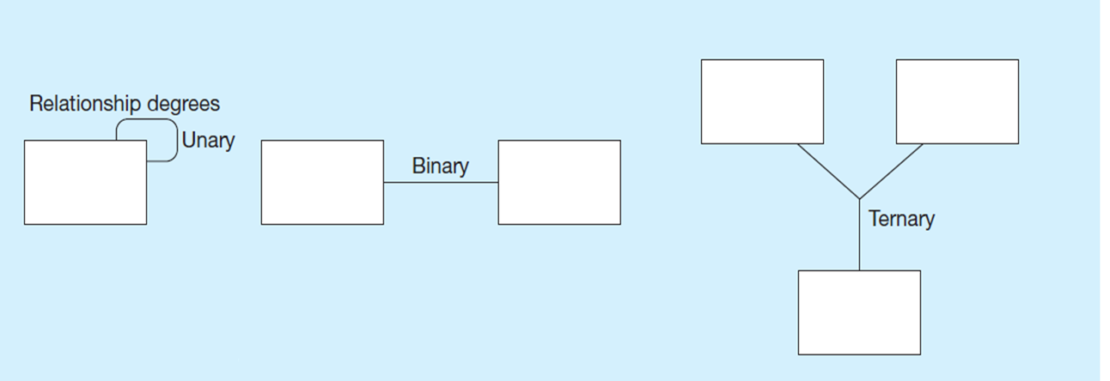
From Figure 2-2 Degrees of Relationships
Unary – entities of the same entity type related to each other
Binary – entities of one type related to entities of another
Ternary – entities of three different types involved in the same relationship
Notes:
One example of unary relationships would be supervisor–subordinate relationships, which exist between employees.
An example of a binary relationship may be an employee working in a department.
A ternary relationship may involve a product being shipped by a particular supplier to a particular warehouse.

Slide 34
Cardinality of Relationships
One-to-One
Each entity in the relationship will have exactly one related entity
One-to-Many
An entity on one side of the relationship can have many related entities, but an entity on the other side will have a maximum of one related entity
Many-to-Many
Entities on both sides of the relationship can have many related entities on the other side

Slide 35
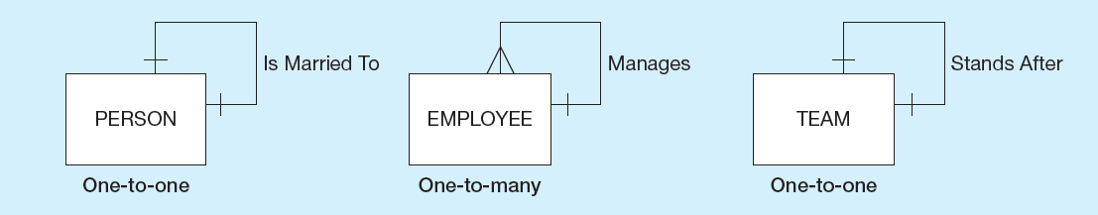
Figure 2-12 Examples of Relationships of Different Degrees (1 of 3)
a) Unary relationships
Notes:
Although this figure of unary relationships shows only one-to-one and one-to-many cardinalities, it is also possible to have many-to-many unary relationships. For example consider a Person entity with a “friend” relationship. A particular person can have many friends, and each friend could in turn have other friends. This is different from the one-to-many relationship of employees. Although a supervisor could manage many subordinates, typically a subordinate only reports to one supervisor.

Slide 36
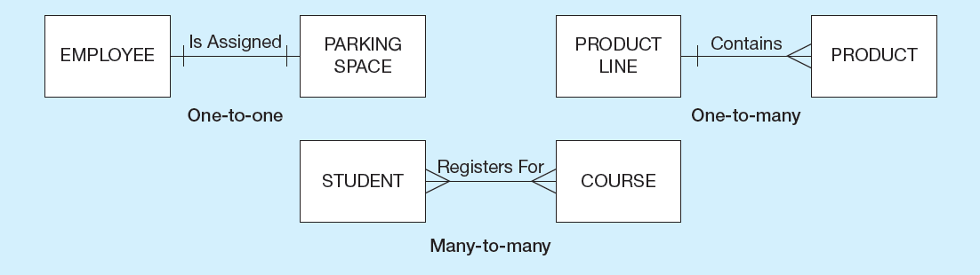
Figure 2-12 Examples of Relationships of Different Degrees (2 of 3)
b) Binary relationships
Notes:
Here are binary degree relationships with all the different possible cardinalities.

Slide 37
☑ Check Point
Relationships have cardinalities of 1:1, 1:M or M:N. Select the ones that should be as of M:N cardinality.  Student – Advisor  Student – Course  Course – PrerequisiteCourse  Course – Session/DayHour  Department – DepartmentHead <--- ANSWER --->
☑ Student – Course ☑ Course – PrerequisiteCourse ☑ Course – Session/DayHour

Slide 38
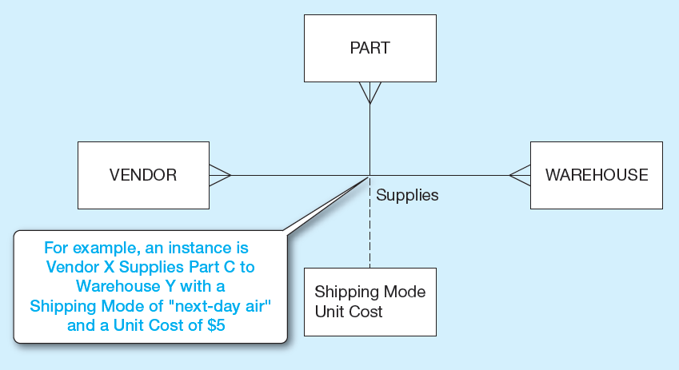
Figure 2-12 Examples of Relationships of Different Degrees (3 of 3)
c) Ternary relationships
Notes:
The cardinality of this ternary relationship is many-to-many-to-many. In other words, each vendor could supply many parts to many warehouses. Each part could come from many vendors and be housed in many warehouses. Each warehouse could have many parts from many vendors.
The dashed line is a way of representing the attributes of the relationship. For a given vendor supplying a given part to a given warehouse, there is a shipping mode and a unit cost. Each of these ternary relationship instances could have its own shipping mode and unit cost.

Slide 39
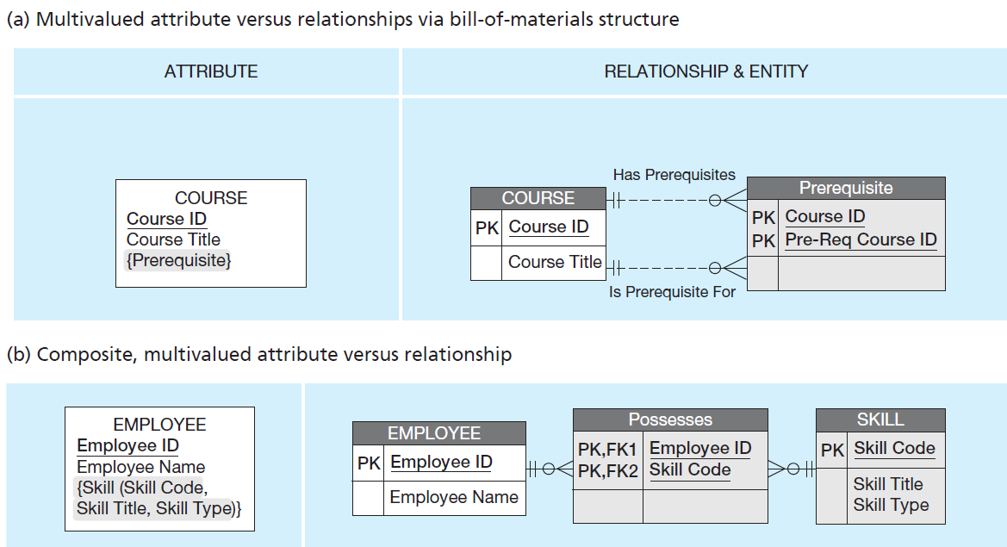
Figure 2-15 Using Relationships and Entities to Link Related Attributes
Multivalued attributes can be represented as relationships
Notes:
In this figure, we see two examples of multivalued attributes on the left. On the right, we see separate entities with relationships.
The top figure shows a simple multivalued attribute, whereas the bottom figure shows a composite multivalued attribute. Note that on the right, it is explicit that there are many to many relationships. For example, although the left side shows that a course can have many prerequisites, there is nothing explicit showing that a course could itself be a prerequisite for multiple other courses. Similarly, on the left it is explicitly shown that an employee can have many skills, but it is not explicitly shown that many employees can share the same skill. The figures on the right, however, do make these facts explicit.
The right side of each figure is in Microsoft Visio notation.

Slide 40
Cardinality Constraints
Cardinality Constraints — the number of instances of one entity that can or must be associated with each instance of another entity
Minimum Cardinality
If zero, then optional
If one or more, then mandatory
Maximum Cardinality
The maximum number
Notes:
Sometimes it is required for an entity to have its related entity, and sometimes not. Also, it is possible for there to be a limit to how many related entities a given entity could be related to.

Slide 41
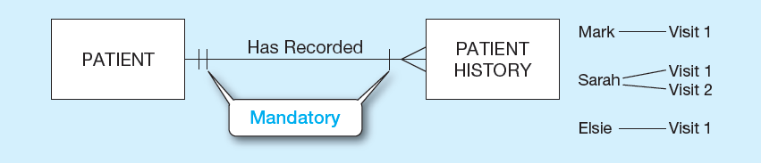
Figure 2-17 Examples of Cardinality Constraints (1 of 3)
a) Mandatory cardinalities
Notes:
Note the hatch mark vs. the circle. A hatch mark illustrates mandatory cardinalities, whereas a circle represents optional cardinalities. This figure indicates that each patient must have had at least one patient history (mandatory), and could have many more (many). By contrast, each patient history (visit) record must be associated with exactly one patient.
Note that in all these E-R diagrams cardinality is represented using something called crow’s foot notation. The three prongs on the many side of the relationship is called a “crow’s foot”. There are other possible notations for E-R diagrams. For example, Microsoft Visio by default shows an arrow from the many side to the one side, although you can change it to crow’s foot notation.

Slide 42
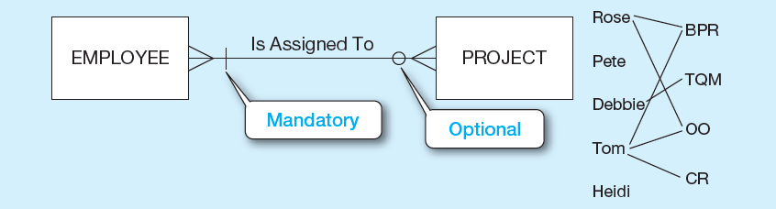
Figure 2-17 Examples of Cardinality Constraints (2 of 3)
b) One mandatory, one optional cardinality
Notes:
This figure shows a binary many-to-many relationship. In this case one side is mandatory and the other is optional. Here every project must have at least one employee assigned to it, but it is possible for an employee not to be assigned to any projects.

Slide 43
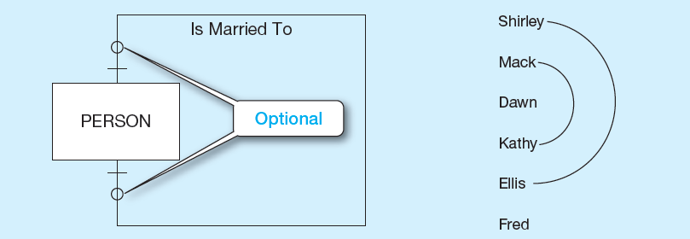
Figure 2-17 Examples of Cardinality Constraints (3 of 3)
c) Optional cardinalities
Notes:
This is a unary one-to-one relationship. According to this, a person could be married to one or no other person. This figure rules out polygamy. Can you see why? How would we be able to allow polygamy in this E-R diagram? (Answer: make it many-to-many).
Dawn and Fred are single. Shirley is married to Ellis, and Mack is married to Kathy.

Slide 44
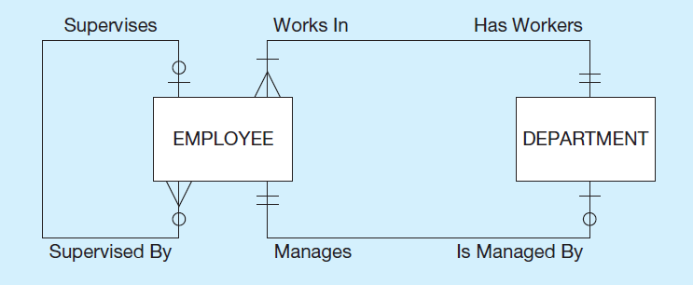
Figure 2-21 Example of Multiple Relationships (1 of 2)
a) Employees and departments
Notes:
Here, we see a one-to-many unary relationship between employees. It shows that a given employee may have exactly zero or one supervisor and could supervise any number of other employees (or none at all).
We also see two binary relationships between employees and departments. First, each department must have at least one, and possibly many, employees. Each employee must work in exactly one department. Also, each department has exactly one employee as a manager, and each employee can manage at most one department, or possibly none at all.
The figure illustrates that there could be multiple types of relationships between the same two types of entities.

Slide 45
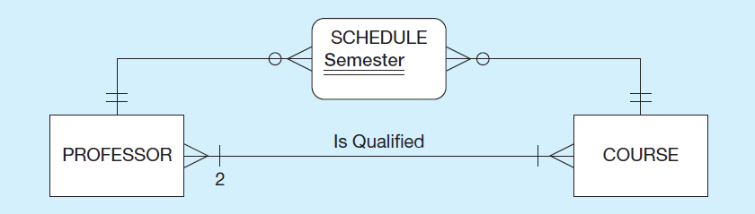
Figure 2-21 Example of Multiple Relationships (2 of 2)
b) Professors and courses (fixed lower limit constraint)
Notes:
Again, we see multiple relationships between two entities, this time between professors and courses. The “Is Qualified” relationship is of binary degree and mandatory many-to-many cardinality. A professor must be qualified to teach at least one course. And a course must have at least two qualified professors; this is a fixed lower limit constraint.
The other relationship is actually implemented via what is called an “associative entity” called Schedule, which has an identifier attribute called Semester. We will shortly talk about associative entities in more detail. This associative entity is implementing a many-to-many relationship between professors and courses, indicating that a particular professor may be scheduled during a particular semester to many courses, and vice versa.

Slide 46
Associative Entities
When should a relationship with attributes instead be an associative entity?
All relationships for the associative entity should be many
The associative entity could have meaning independent of the other entities
The associative entity preferably has a unique identifier, and should also have other attributes
The associative entity may participate in other relationships other than the entities of the associated relationship
Convert ternary relationships to associative entities

Slide 47
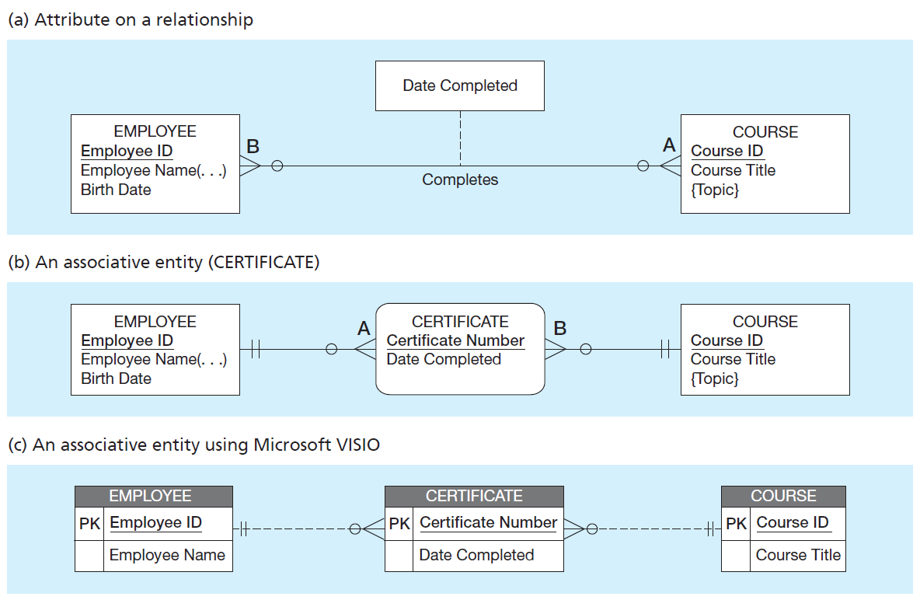
Figure 2-11 Associative Entities
An associative entity is an entity. It has attributes. It is also a relationship. It serves to link other entities together in a many-to-many relationship.
Notes:
In Figure (a), the date completed attribute pertains specifically to the employee’s completion of a course… it is an attribute of the relationship. The relationship simply states that an employee completed a course on a particular date. The completion is represented as a relationship, and is not an entity unto itself.
In Figure (b), the simple relationship has been replaced with an associative entity. A certificate is considered to be an entity unto itself, and in fact even has a unique identifier attribute. An associative entity is like a relationship with an attribute, but it is also considered to be an entity in its own right.
Note that the many-to-many cardinality between entities in Figure 2-11a has been replaced by two one-to-many relationships with the associative entity. The associative entity is always on the many side of the relationship it links. One many-to-many relationship has been replaced by two one-to-many relationships.

Slide 48
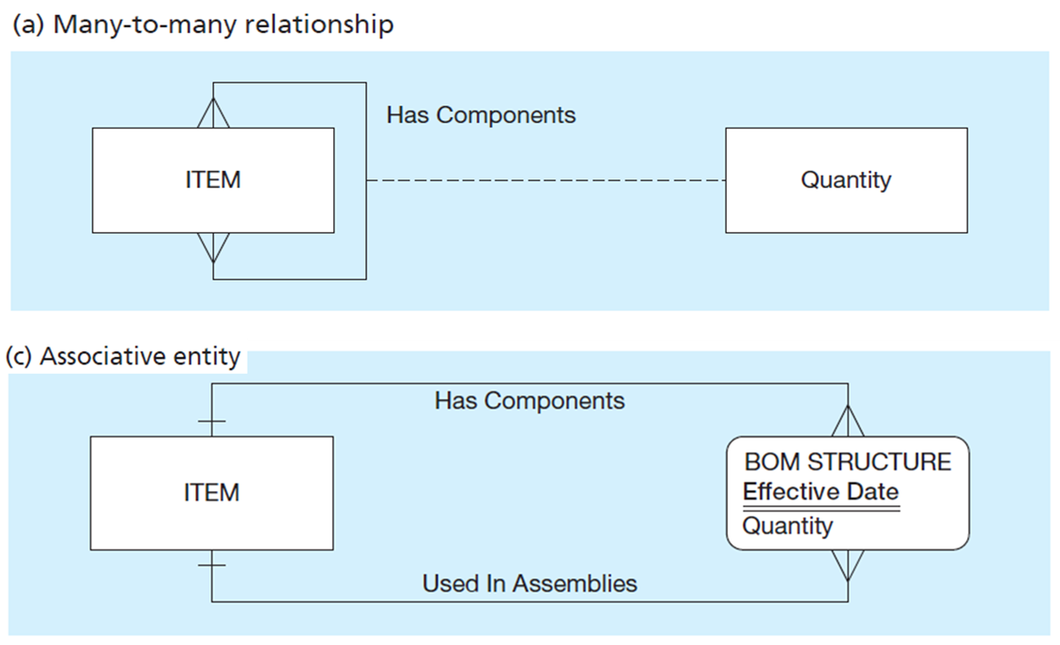
Figure 2-13 Representing a Bill-of-Materials Structure (1 of 2)
Two ways to represent a bill-of-materials structure
Notes:
In (a) and (c) we see another contrast of using a relationship with attributes vs. an associative entity. Here, a unary many-to-many relationship is converted into two one-to-many relationships between the ITEM entity and the BOM STRUCTURE associative entity. Note that Effective Date is a partial identifier, which implies that BOM STRUCTURE is a weak entity with respect to ITEM.

Slide 49
☑ Check Point
Which one of the following items best resembles an associative entity? A) Diploma B) Transcript/Grade C) Course D) Student <--- ANSWER --->
A) Diploma

Slide 50
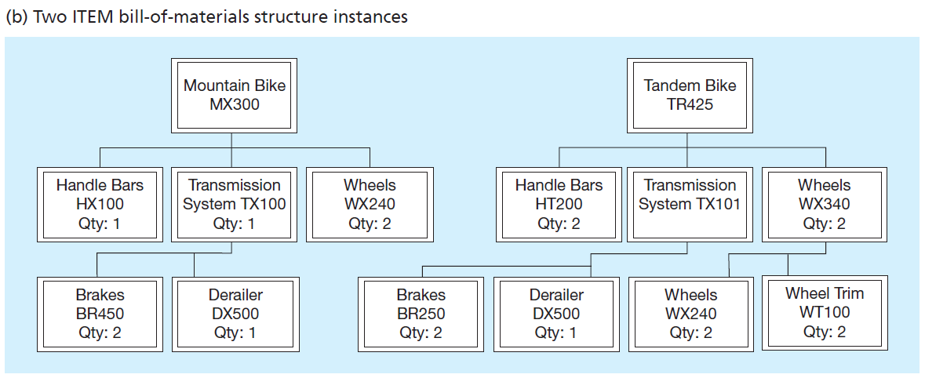
Figure 2-13 Representing a Bill-of-Materials Structure (2 of 2)
A bill-of-materials is a hierarchy of items. Here, bikes are composed of handle bars, transmissions, wheels, etc. Transmissions include their own sub-parts, brakes and derailers.
Notes:
Unary relationships (especially one-to-many and many-to-many) often depict hierarchies. Bill-of-materials is one example. Another example is the supervisor relationship between employee entities in Figure 2-21 (slide 41). That relationship also depicts a hierarchy, this time of employees.

Slide 51
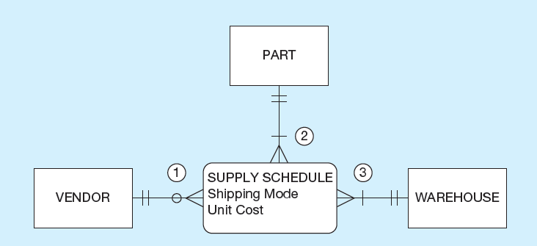
Figure 2-18 Cardinality Constraints in a Ternary Relationship
The three relationships are marked by their mandatory or optional constraints. #1 states that a vendor may or may not supply parts to warehouses. #2 states that each part must come from a vendor and go to a warehouse. #3 says a warehouse must have at least one part from a vendor.
Notes:
It is recommended that ternary relationships with attributes be converted into associative entities. Although Figure 2-12c (slide 35) works to depict the general ternary relationship, it is insufficient for depicting the mandatory and optional cardinalities as we see here.

Slide 52
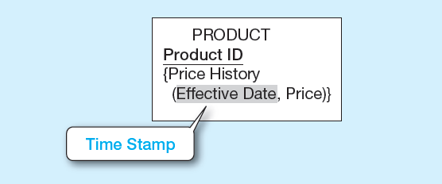
Figure 2-19 Simple Example of Time-Stamping
Time stamp – a time value that is associated with a data value, often indicating when some event occurred that affected the data value.
The Price History attribute is both multivalued and composite.
Notes:
Time stamps are useful for keeping historical data. In this case, we see a way of keeping track of price changes over time for products.
Can you think of how the price history could be represented as a separate entity instead of a multivalued attribute? What would be the cardinality of the relationship between product and price history? (Answer: one-to-many).

Slide 53
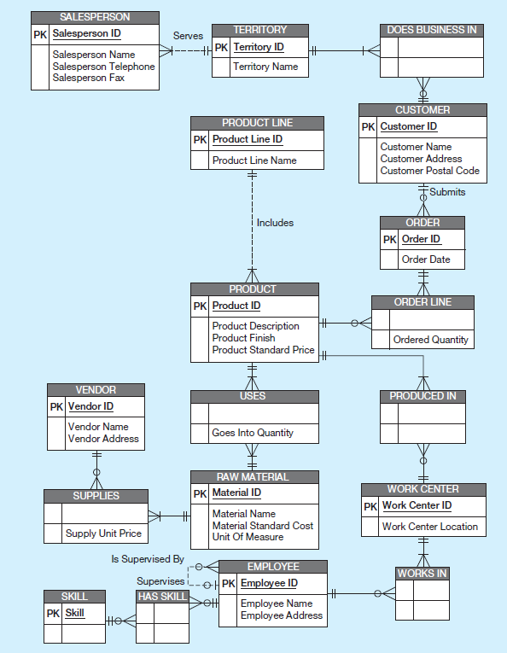
Figure 2-22 Data Model for Pine Valley Furniture Company in Microsoft Visio Notation
Different modeling software tools may have different notation for the same constructs.
Notes:
As you can see, data models can be quite comprehensive, including many different entities and relationships.

Slide 54

Copyright

